Slide 1
Effect of superfluid vortices and magnetic field on the power spectrum of flow fluctuations in heavy-ion collisions
Ajit M. Srivastava
Institute of Physics
Bhubaneswar, India

Slide 2
Outline: Talk divided in three parts
Power spectrum of flow fluctuation coefficients v_{n}:
Valuable probe for initial fluctuations: like CMBR power spectrum.
Hydrodynamics simulations: Non-trivial structure of flow power
spectrum, information about freezeout horizon, viscosity,…..
2. Probing high baryon density phases through vorticity detection
CFL phase, nucleon superfluidity (as in pulsar glitches): All lead
to superfluid vortices. Qualitative effects on flow power spectrum.
New focus for FAIR and NICA: very low energy collisions with neutron rich nuclei to get nucleon superfluidity
Possibility of probing pulsar vortices in heavy-ion collisions
3. Magnetic fields and Flow fluctuations:
Effect of magnetic field on Flow: Enhancement of elliptic flow,
(η/s larger than AdS/CFT limit?), power difference in even-odd v_{n}
Magnetohydrodynamics simulations
B. Effect of flow on magnetic field: Enhancement of magnetic field.
Recent work: Flux re-alignment, Dynamo effect from vorticity

Slide 3
Part 1: Power spectrum of Flow fluctuations:
Recall: Elliptic Flow: QGP region anisotropic in non-central collisions
collision along
z axis
y
central pressure = P₀
Collision
region
Outside
P = 0
x
z
Spectators
Anisotropic shape implies:
Important: Initially no transverse expansion
Anisotropic pressure gradient implies:
Buildup of plasma flow larger in x direction
than in y direction

Slide 4
y
Initial particle momentum distribution
isotropic : it develops anisotropy due
to larger flow in x direction
This momentum anisotropy is
characterized by the 2nd Fourier
coefficient V₂
x
(Elliptic flow)
Note: Elliptic flow strong evidence for thermalization. No other way
To get anisotropic momentum distribution only from spatial anisotropy.
Led to very important results:
Strong constraints on η/s : values determined to be in range
1 -3 times AdS/CFT bound. Lower than any known liquid.
Long realized that initial fluctuations affect determination of event
Plane and initial eccentricity.
Earlier discussions mostly focused on a couple of Fourier
coefficients, V_{n} with n = 2, 4, 6, 8 (Note: no odd harmonics)

Slide 5
Power spectrum of flow fluctuations: New approach to flow analysis
Mishra, Mohapatra, Saumia, AMS: PRC 77, 064902 (2008); 81, 034893 (2010)
Inhomogeneities of all scales present, even in central collisions: Arising from initial state fluctuations
These anisotropies were known earlier, however, they were only
discussed in the context of determination of the eccentricity for elliptic flow calculations.
We argued that due to these initial state fluctuations all flow
coefficients will be non-zero in general:
All Fourier coefficients V_{n} are of interest (say, n=1 to 30 -40,
including Odd harmonics, these were never discussed earlier,
For example, triangular flow is discussed now only as arising from Initial state fluctuations.
We emphasized: Learn from CMBR power spectrum analysis: Calculate root-mean-square values of V_{n} , and NOT their average values.

Slide 6
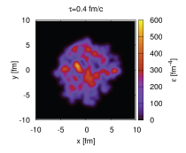
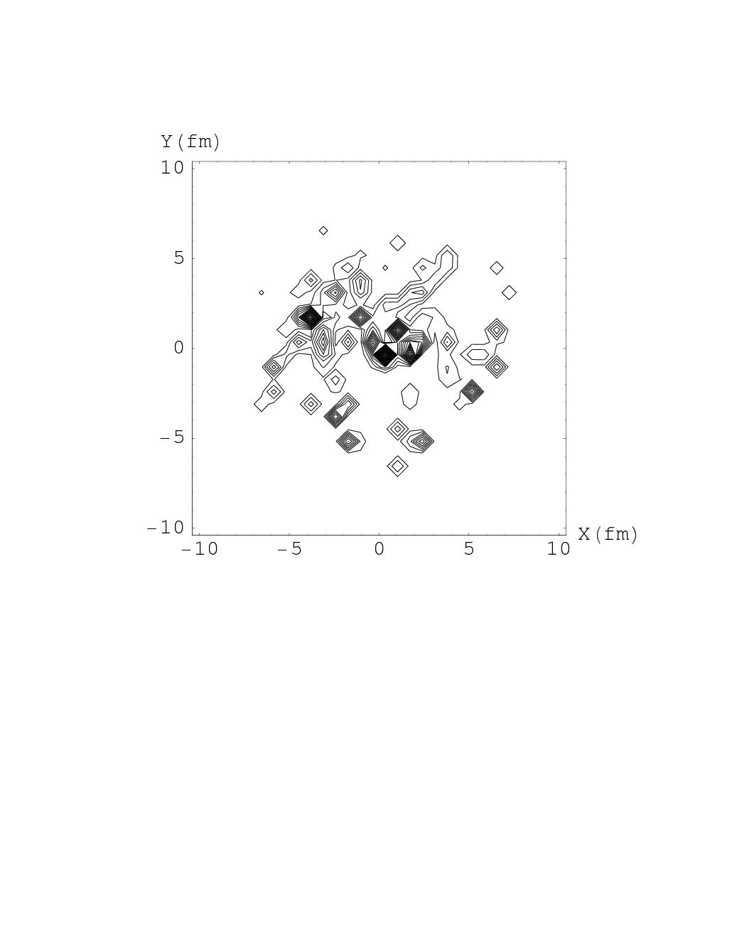
Initial state fluctuations
transverse energy density:
Au-Au central collision
at 200 GeV/A, HIJING
(Blaizot’s talk, Matter at
extreme conditions, 2014)
Thus: the equilibrated matter will also have azimuthal anisotropies
(as well as radial fluctuations) of similar level.

Slide 7
Important lesson for heavy-ion collisions from CMBR analysis
CMBR temperature anisotropies analyzed using Spherical Harmonics
Now: Average values of these expansions coefficients are zero
due to overall isotropy of the universe
However: their standard deviations are non-zero and contain
crucial information.
This gives the celebrated Power Spectrum of CMBR anisotropies
Lesson : Apply same technique for RHICE also

Slide 8
For central events average values of flow coefficients will be zero
(same is true even for non-central events if a coordinate frame with fixed orientation in laboratory system is used).
Following CMBR analysis,we proposed to calculate root-mean-square values of these flow coefficients using a lab fixed coordinate system,
And plot it for a large range of values of n = 1, 30-40
These values will be generally non-zero for even very large n
and will carry important information

Slide 9
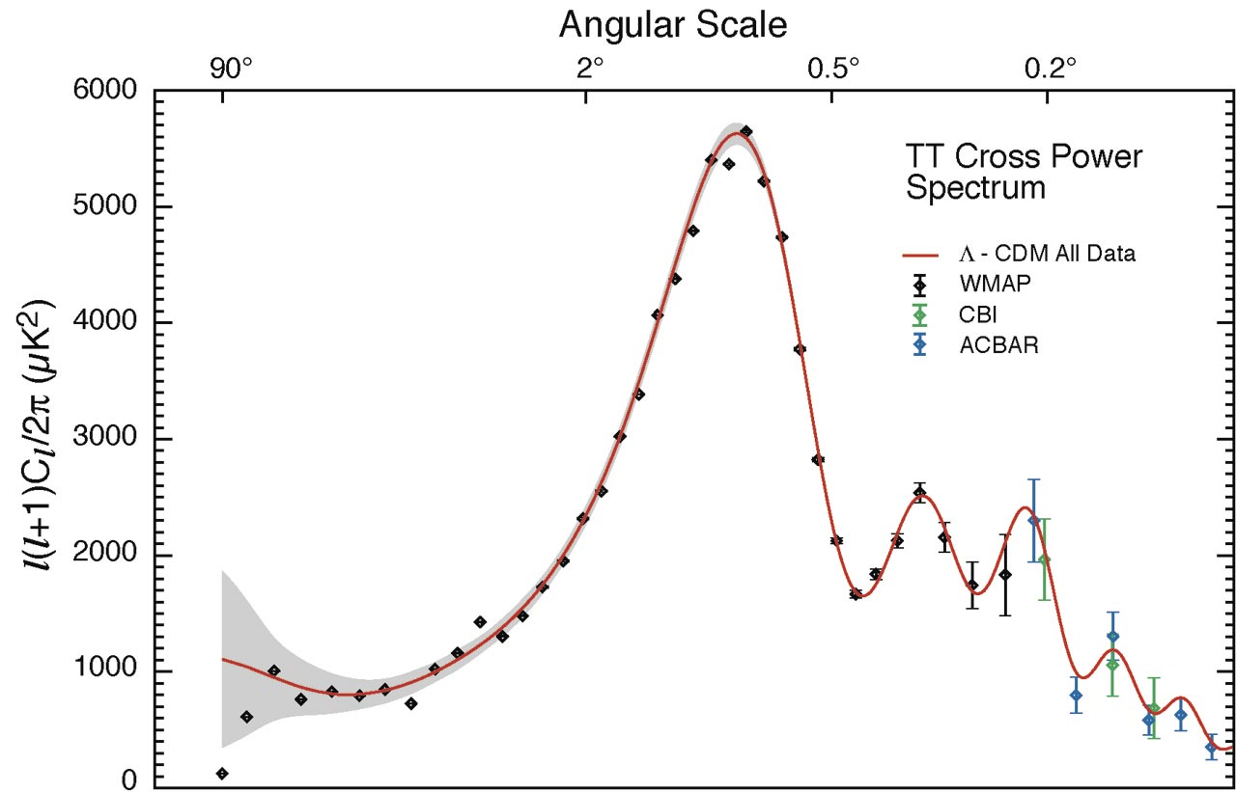
Recall: Acoustic peaks in CMBR anisotropy power spectrum
Solid curve:
Prediction from
inflation
Can such a power spectrum be plotted for heavy-ion collisions ?
So far we discussed: Plot of V_{n}^{rms} for large values of n will
give important information about initial density fluctuations.
We now discuss: Such a plot may also reveal non-trivial structure
like acoustic peaks for CMBR as above.

Slide 10
References :
The suggestion to plot this “power spectrum” for relativistic
Heavy-ion collision experiments was first given by us
(Mishra, Mohapatra, Saumia, AMS) in the following papers :
Super-horizon fluctuations and acoustic oscillations in
relativistic heavy-ion collisions: PRC 77, 064902 (2008)
2) Using CMBR analysis tools for flow anisotropies in relativistic heavy-ion collisions: PRC 81, 034903 (2010)
It was emphasized in these papers that such a plot will have
Valuable information about nature of fluctuations, especially
initial fluctuations, and will be non-trivial for all n (up to about
30, including odd n).
This applies to all collisions, including central collisions.

Slide 11
An Important feature of flow power spectrum
Fluctuations with superhorizon wavelengths
Meaning of Horizon for the Universe:
Horizon size = speed of light c X age of the universe t
No physical effect possible for distances larger than this
In the universe, density fluctuations with wavelengths of
superhorizon scale have their origin in the inflationary period.
Tiny fluctuations are stretched by superluminal expansion
Meaning of Horizon for Heavy-ion collisions:
System equilibrates in time τ₀ less than 1 fm/c. Horizon size = c τ₀
No physical effects possible for distances larger than c τ₀ = 1 fm.
Note: Fluctuations present of all wavelengths even at time τ₀
(arising from N-N collisions and fluctuations in nucleon positions).
All fluctuations larger than 1 fm are superhorizon at time τ₀.
At any later time τ, any fluctuation larger than cτ is superhorizon.

Slide 12
We argued that sub-horizon fluctuations in heavy-ion collisions should display oscillatory behavior just as fluctuations for CMBR
What about super-horizon fluctuations ?
Recall: For CMBR, the importance of horizon entering is for the growth of fluctuations due to gravity.
This leads to increase in the amplitude of density fluctuations, with subsequent oscillatory evolution, leaving the imprints of these important features in terms of acoustic peaks.
Superhorizon fluctuations for universe do not oscillate (are frozen,
as we discussed earlier).
Importantly, they also do not grow,
That is: they are suppressed compared to the fluctuation which
enters the horizon.

Slide 13
For heavy-ion collisions, there is a similar (though not the same, due to absence of gravity here) importance of horizon entering.
One can argue that flow anisotropies for superhorizon fluctuations
in heavy-ion collisions should be suppressed by a factor
where H^{s}_{fr} is the sound horizon at the
freezeout time t_{fr} (~ 5-10 fm for heavy-ion collisions)
This is because here spatial variations of density are not directly detected, in contrast to the Universe where one directly detects the spatial density fluctuations in terms of angular variations of CMBR.
For heavy-ion collisions, spatial fluctuation of a given scale (i.e. a definite mode) has to convert to fluid momentum anisotropy of the corresponding angular scale. This will get imprinted on the final hadrons and will be experimentally measured.
This conversion of spatial anisotropy to Momentum ansitropy (via pressure gradients) is not effective for Superhorizon modes.
Thus: Superhorizon modes will be suppressed in heavy-ion collisions

Slide 14
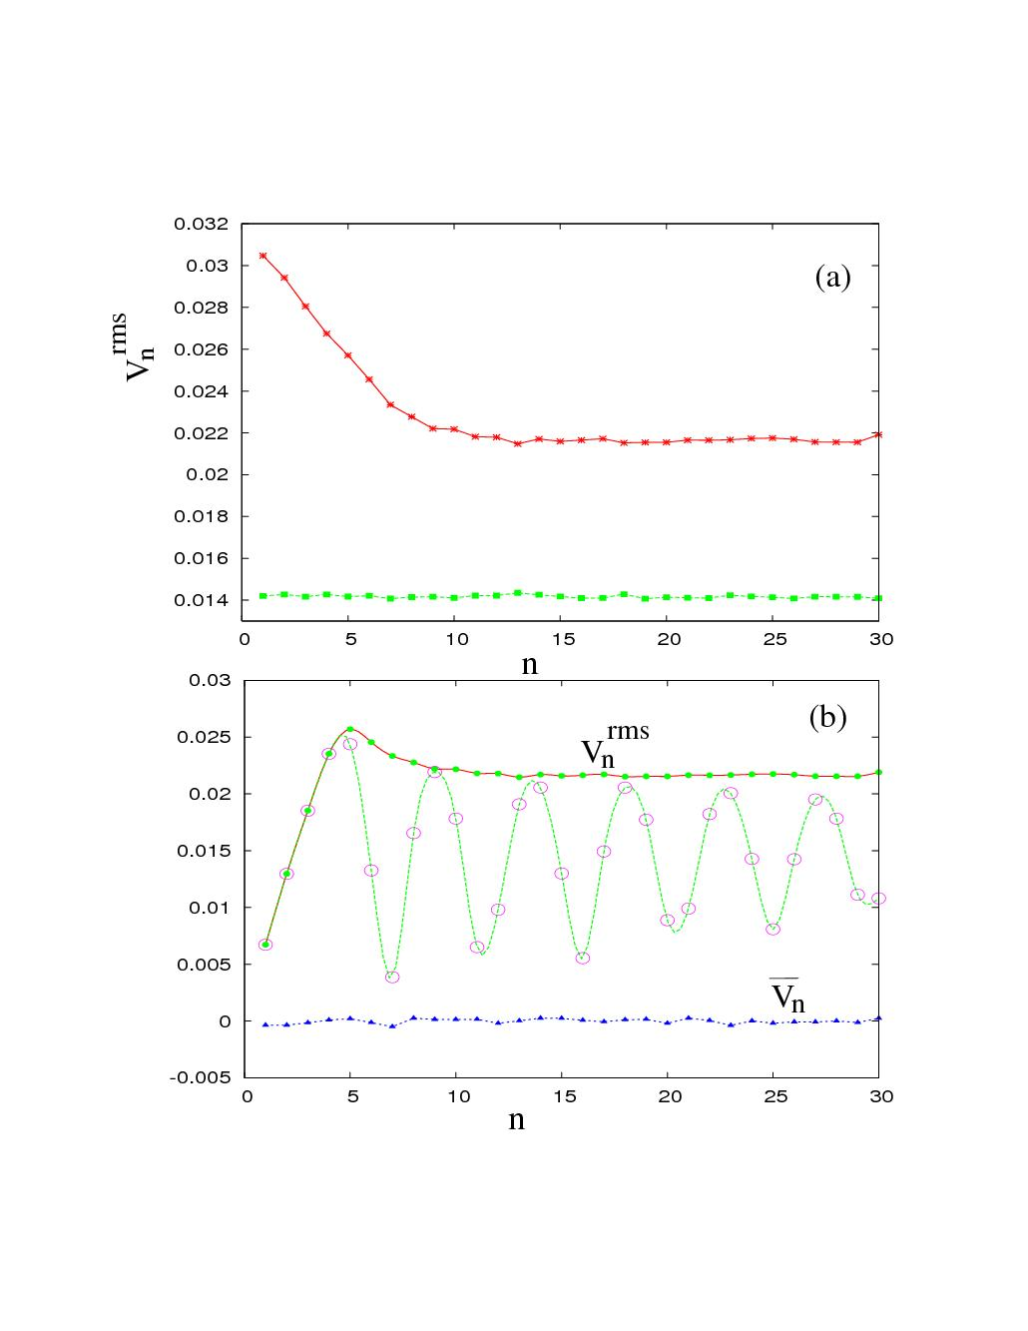
Results: (modeling only, no hydrodynamical simulation here yet)
HIJING parton distribution
Errors less
than ~ 2%
uniform distribution of partons
Include superhorizon
suppression
Include oscillatory
factor also
Note: Dissipation, e.g. from viscosity, diffusion, will damp higher n modes

Slide 15
Paul Sorensen “Searching for Superhorizon Fluctuations in
Heavy-Ion Collisions”, nucl-ex/0808.0503
See, also, youtube video by Sorensen from STAR: http://www.youtube.com/watch?v=jF8QO3Cou-Q

Slide 16
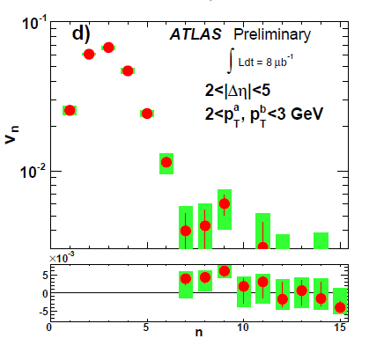
Focus on dip
for low n below
First peak
1st peak
at n = 3
2nd peak
at n = 9
1st dip
At n = 7
1st peak
at n = 5
2nd peak
at n = 9
1st dip
at n = 7

Slide 17
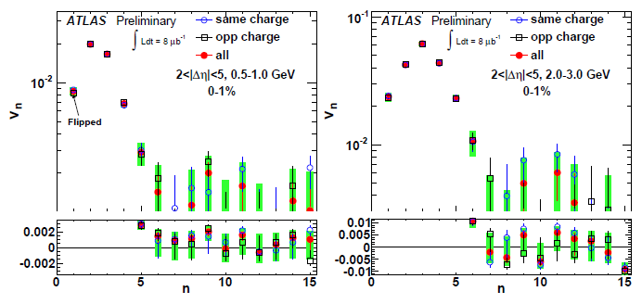
arXiv: 1107.1468, LHC Pb-Pb at 2.76 TeV
Note: Very important to understand suppression of low n harmonics
It contains the information about freezeout horizon size

Slide 18
Relativistic Hydrodynamics Simulations:
(Saumia P.S., AMS, arXiv: 1512.02136, Mod. Phys. Lett. A, Oct. 2016)
We have developed two independent codes for hydrodynamic
simulation for heavy-ion collisions. We compare the results of both
Simulations and cross-check for consistency.
One simulation is 3-D simulation with random Gaussian fluctuations
of specific width on a Woods-Saxon background corresponding to
QGP with initial temperature of 500 MeV.
Power spectrum are obtained for the central rapidity region.
Second one is a 2-D simulation with Bjorken scaling model. Initial
density profile is obtained from Glauber initial conditions for Pb-Pb
collision at 200 GeV energy.
We study power spectrum of spatial anisotropies, momentum
anisotropies, time evolution of power spectrum and the peak
structure in the power spectrum.
Our results show startling correspondence with evolution of
fluctuations in the universe and CMBR power spectrum, in complete
agreement with our earlier predictions.

Slide 19
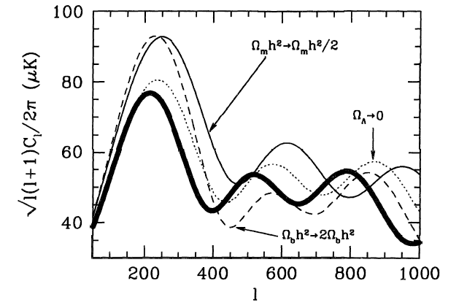
Changes in the location of peaks with energy-matter
density of the Universe, (apparent horizon size changes)

Slide 20
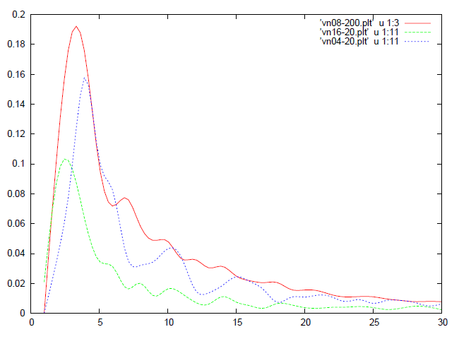
Results of the simulation:
Plots of V_{n}^{rms} vs. n for Gaussian fluctuations of width s
Note: Here peak position gives information
about length scale
of fluctuations
Just as for CMBR, where first peak location directly gives size of largest fluctuation at last scattering surface
Blue plot: s = 0.4 fm
Red plot: s = 0.8 fm
Green plot: s = 1.6 fm
Woods-Saxon density profile, 2 fm radius with 10 Gaussian fluctuations, To=500 MeV

Slide 21
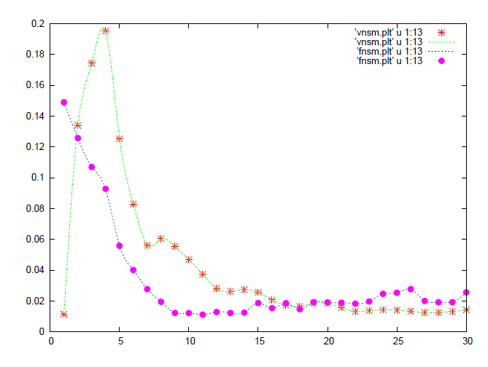
Evidence for Superhorizon suppression
Superhorizon
suppression
Power spectrum of
momentum anisotropies
Power spectrum of
spatial anisotropies
Conclusions for Part 1: Power spectrum of flow fluctuations is a
valuable probe for fluctuations and their evolution in heavy-ion
collisions: Just like CMBR power spectrum in the universe

Slide 22
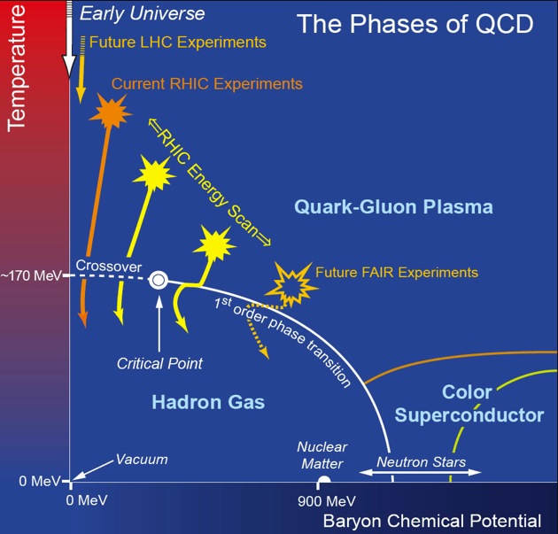
Part 2:
Probing high baryon density phases through vorticity detection
(Arpan Das, Shreyansh Dave, Somnath De, AMS, arXiv: 1607.00480)
Recall: QCD
Phase diagram
High density transition to exotic phases: superfluidity: Vortices ?
Note: Possibility of Nucleon superfluidity for low energy collisions ?
Qualitative effects on the power spectrum, clean signal of vorticities.

Slide 23
Different phases at high baryon density:
At ultra-high baryon density – very large chemical potential.
asymptotic freedom makes Perturbative calculations reliable.
One-gluon exchange: quark-quark interaction attractive
in 3* channel
Cooper problem: Any attractive interaction destabilizes Fermi surface
BCS pairing of quarks in 3* channel: Color Superconductivity
Quark Cooper pair: , α,β color, i,j, flavor, a,b spin
Consider most symmetric case: all three flavors masssless
(not unreasonable for very high chemical potential)

Slide 24
Color-Flavor Locked (CFL) phase:
color antisymmetric, spin antisymmetric, flavor antisymmetric:
pairing pattern:
Note: This is invariant under equal and opposite
rotations of color and (vector) flavor:
Leads to following spontaneous symmetry breaking
Color SU(3) spontaneously broken
Other possible pairings: 2 light flavors: 2SC pairing
Breaks Color SU(3) to color SU(2) symmetry.

Slide 25
Topological properties of the CFL phase:
CFL spontaneous symmetry breaking pattern:
Check: Homotopy groups of the vacuum manifold
So: No domain wall,
or monopole defects
String defects: superfluid vortices
Doubling of colored Skyrmions (baryons)

Slide 26
Implications of the Topological Analysis:
Universality implies that:
Transition to CFL phase will invariably lead to formation of
suerfluid vortices:
These will lead to strong fluid circulation right from the initial
stage of transition:
It is obvious that resulting flow pattern will be dramatically
different from the case without any vortex.
Thus: Qualitative changes in the flow pattern, specifically the flow power spectrum can give clean signal of transition to these
Exotic phases of QCD.
Important to note: Nucleon superfluidity is believed to exist in the interiors of neutron stars.
Strong support from pulsar glitches

Slide 27
Superfluid phase of neutron star:
Observations:
Pulsars are rapidly Rotating neutron stars,
detected by their periodic pulses (electromagnetic waves),
Beamed emission from the magnetic poles of the neutron star.
Superfluid phase in the interior allows for vortex lattice to form.
Vortices are pinned at the interface with crust.
Superfluid vortices play fundamental role in determining rotational
properties of neutrons star, hence pulsar timings.
Phenomenon of glitches explained by vortex depinning from crust.
Sudden transfer of angular moment from superfluid to outer crust
Leads to glitches in pulsar timing.

Slide 28

(from
Internet)
Inner Core:
Size ~ 1 Km
QCD phases:
QGP, CFL, etc.
0.2 km
1 km
9 km
Outer Core:
Size ~ 9 Km
Superfluid
Phases of
Nucleons
Superfluid
Vortices play
Important role
in glitches
1 km

Slide 29
Inner Crust region:
Superfluid ¹S₀ phase appears in the inner crust region:
Extending from ρ ∼ 4 x 10¹¹ g/cm³ to 2 x 10¹⁴ g/cm³
For the ³P₂ channel, the interaction becomes strongly attractive only at higher density, this occurs in the core of the neutron star.
This phase is quite like the superlfuid phase of ³He
Allows for non-trivial order parameter, and hence associated
topological defects.
Even though nucleon superfluid vortices play crucial role in understanding of pulsar glitches,
Only theoretically investigated so far
Thee have never been seen in any experiment.

Slide 30
Proposal: Very low energy collisions of neutron rich nuclei
(possibly superheavy, near neutron dripline) may create
bulk phase of nucleon superfluidity.
Possible at FAIR and NICA
This is a suggestion for another direction:
Surely QGP search is very exciting and novel:
But so is the search for the superfluid phase of nucleons, and
the associated vortices which are believed to play crucial role
in pulsar dynamics
Our signals can detect nucleon superfluid vortices and
investigate their properties under direct experimental control.
Very important for understanding of neutron star properties.
Nucleon superfluid transition temperautre: 0.2 MeV to 5 MeV
Density ρ ∼ 10⁻⁴ρ₀ , ρ₀ is nuclear saturation density
Such temperatures/densities are within reach at FAIR and NICA:

Slide 31
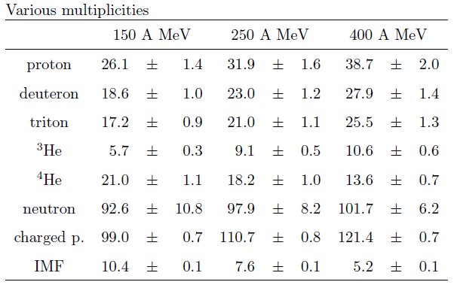
Collisions of Au on Au with the FOPI-facility at GSI Darmstadt.
E/A 150 250 400 MeV/A (incident)
T 17.2 ± 3.4 26.2 ± 5.1 36.7 ± 7.5 MeV
(results from blast model fit)
Freezeout density =
0.4 x nuclear saturation density
nucl-ex/9610009
Intermediate mass fragments z>2
Au-Au collisions at E/A = 50, 100, 150, and 200 MeV, at heavy-ion
synchrotron SIS, T ~ 4-5 MeV is reached (nucl-ex/9801006)
Lower energy collisions or, a more dilute system quite likely to give lower T and correct ρ for superfluid transition
UrQMD simulations in Progress.

Slide 32
Properties of CFL vortices:
Correlation length:
Velocity profile:
For r < ξ
For r > ξ
Results shown for T_{c} = 50 MeV, μ_{q} = 500 MeV, T = 25 MeV
Resulting ξ = 0.7 fm, v₀ = 0.3
Same velocity profile holds for nucleon superfluid vortices,
For that case, T_{c} = 0.3-5 MeV, ξ ∼ 1 fm

Slide 33
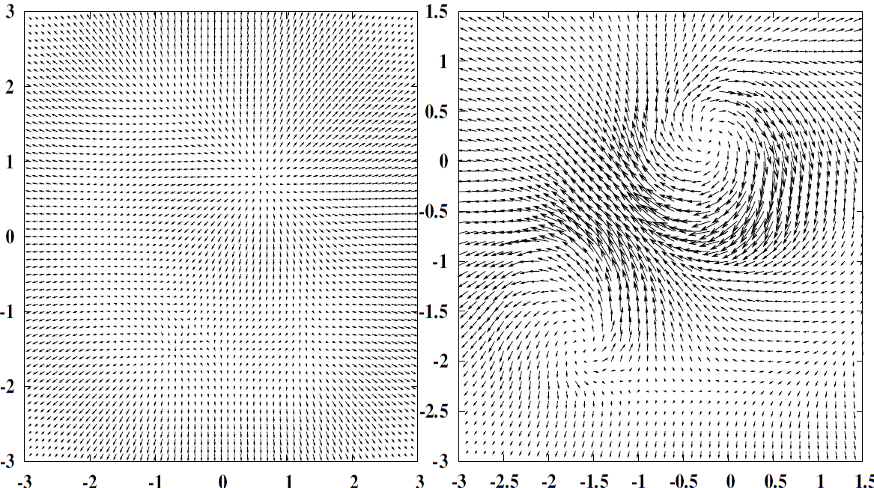
Results of relativistic hydrodynamics simulations with two-fluid
picture of superfluid (normal component and superfluid component)
Qualitatively different features of flow pattern and power spectrum
Signalling superfluid transition
Velocity profile at central rapidity without (left) and
With (right) vortices: τ–τ₀ = 0.84 fm/c

Slide 34
Power spectrum at t-t0 = 1.68 fm for central collision. Different plots show the power spectrum for the cases of no vortex, single vortex, a V-V pair, and a V-AV pair.
Recall: for central collisions we expect very small elliptic flow
Inset shows dependence of elliptic flow at different times on the superfluid fraction for the V-AV case showing very large initial elliptic flow.

Slide 35
Time evolution of the power spectrum for the case
with a V-V pair showing the difference in the power for even
and odd Fourier coefficients for early times. Could be probed by thermal photon elliptic flow, or peripheral collisions.

Slide 36
Plot of v₂ and v₄ for non-central collisions for a Vortex-Anti-vortex pair along z axis, and a single vortex along the x axis, showing negative elliptic flow at initial stages as well as large (negative) values of v₄
Conclusions for Part 2: Superfluid vortices can be detected using flow power spectrum: FAIR and NICA can probe pulsar vortices using very low energy collisions: Focused effort needed

Slide 37
Part 3: Magnetic field and flow fluctuations:
A: Effect of Magnetic Field on plasma waves, hence on flow:
A conducting plasma in the presence of magnetic field will evolve according to the equations of magnetohydrodynamics.
In presence of magnetic field, there are three types of waves in the plasma in place of ordinary sound waves.
Fast magnetosonic waves: Generalised sound waves with significant contributions from the magnetic pressure.
Their velocity is given by c²₊~c²_{s} + v²_{A}sin²θ where θ is the angle between the magnetic field B₀ and the wave vector and the Alfven velocity v_{A}=B₀/√4πρ
Slow magnetoacoustic waves: Sound waves with strong magnetic guidance. c²₋=v²_{A}cos²θ
Alfven waves: Propagation of magnetic field perturbations.

Slide 38
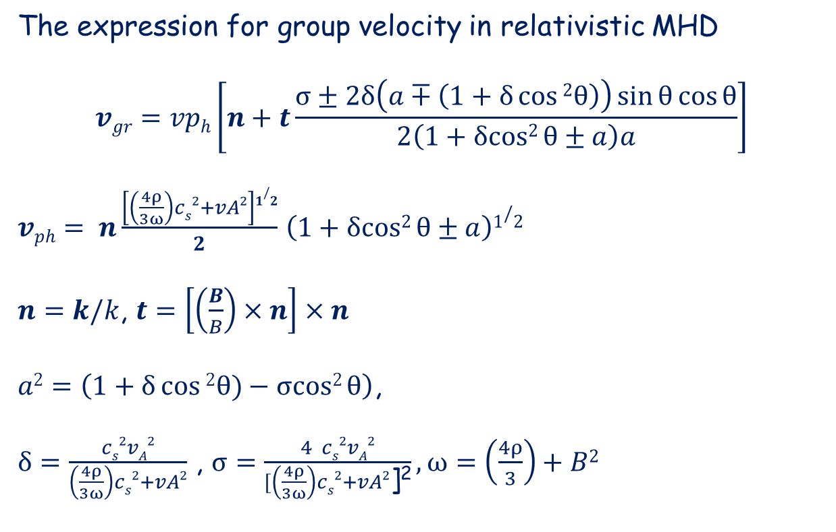
B
n
v_{gr}
θ
x
t
Note: Direction of group velocity depends on the coefficient of t
above, which depends on local pressure (for a given B).
Thus: with pressure variations, direction keeps changing,
Thus: Complex flow pattern even with radial expansion

Slide 39
Our earlier work:
The effect of magnetic field on v_{n} was modeled as follows:
(For elliptic flow we know that v₂ /ε c_{s} )
Generate initial density fluctuations from HIJING
Calculate F_{n} (the Fourier coefficients of spatial anisotropy)
v_{n} is calculated from F_{n} , now as proportional to group velocity which in turn is a function of the azimuthal angle.
R.K.Mohapatra, P.S. Saumia, AMS, MPLA26, 2477 (2011).
B
n
v_{gr}
Magnetic field B is taken to be proportional to the impact parameter b,
with maximum value
B = 10¹⁵ Tesla
at b = 10 fm.
x
t

Slide 40
Magnetic field along Y axis:
Flow along X axis deforms magnetic field:
higher Energy cost compared to flow along Y axis
Equation of state becomes anisotropic:
Speed of sound larger along x axis compared to y axis
Flow from initial spatial anisotropy is proportional to sound speed
Thus: Flow along X axis becomes larger than along Y axis:
This enhances elliptic flow.
Can this accommodate larger values of viscosity ?
Note: If magnetic field points along X axis?
This should suppress elliptic flow.
We confirmed this using magnetohydrodynamics simulations
Possible to achieve using deformed nucleus (U on U)

Slide 41
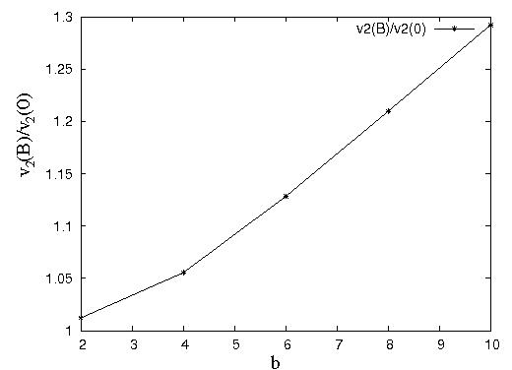
Enhancement of elliptic flow v₂ with magnetic field (up to 30 %)
R.K.Mohapatra, P.S. Saumia, AMS, MPLA26, 2477 (2011).
B ~ 0.5 b m_{π}²
(fm)
B/m_{π}² = 1 1.5 2 2.5 3 3.5 4 4.5 5
Subsequent analysis by Tuchin: Results in agreement with this
K. Tuchin, J.Phys. G 39, 025010 (2012)

Slide 42
Relativistic Magneto-Hydrodynamics Simulations:
(Arpan Das, Shreyansh Dave, Saumia Pandiat, AMS)
Equations of relativistic MHD: (follow formalism from: Mignone and Bodo, Mon. Not. R. Astron. Soc. (2005)
We solve these equations using Leapfrog algorithm of
second order. For large velocities, accuracy not enough, so
Keep evolution for short times and for small gradients.
Initial Conditions: Distribution of energy density, magnetic
Field, velocities (taken to be zero)
Equation of state: relativistic ideal gas, given T, μ

Slide 43
Enhancement of elliptic flow v₂ with magnetic field
Prediction based on magnetosonic waves:
Using HIJING for Au-Au at 200 GeV
Results of present MHD simulation:
For T = 130 MeV, μ_{q} = 500 MeV
v₂(B)/v₂(0)
v₂(B)/v₂(0)
(fm)
B/m_{π}² = 1 1.5 2 2.5 3 3.5 4 4.5 5
R.K.Mohapatra, P.S. Saumia, AMS,
MPLA26, 2477 (2011).
B/m_{π}²
A.Das, S. Dave, Saumia P.S., AMS
Can this accommodate larger values of η/s ?

Slide 44
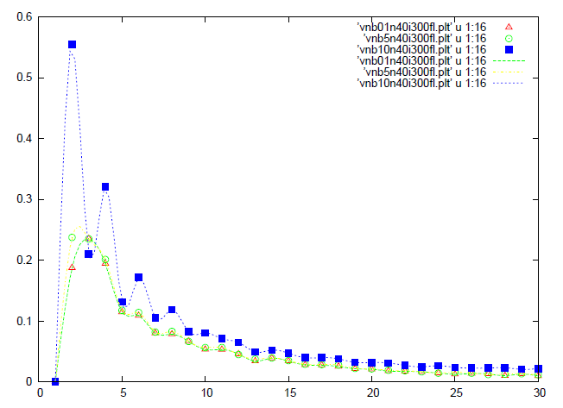
B = 0.01,5,10 mπ², t = 1.3 fm, with fluctuations
Plots of V_{n}(rms) vs. n - Full Power spectrum

Slide 45
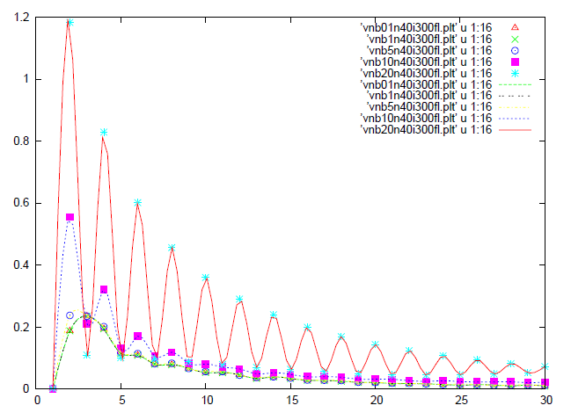
By = 0.01,5,10,20 mπ², t = 1.3 fm, with fluctuations
Plots of V_{n}(rms) vs. n - Full Power spectrum
Note: marked suppression of odd
harmonics for large B: Distinctive
Signal for presence of strong
magnetic field at early times

Slide 46
Part 3B: Magnetic field enhancement from flow
(Arpan Das, Shreyansh Dave, Saumia Pandiat, AMS)
Magnetic field realignment due to density fluctuations: Initial
Increase in B, before it decreases due to expansion
with density fluctuations
B/B₀
without density fluctuations
τ−τ₀

Slide 47
Dynamo effect at play in Heavy-ion collisions:
Huge enhancement in magnetic field due to plasma
Turbulence (from vortices): Flow energy feeds growth of B
with fluctuations, and a
Vortex-antivortex pair
B/B₀
With fluctuations, no vortices
no fluctuations, no vortices
τ−τ₀

Slide 48
Dynamo effect: Cont….
B/B₀
with fluctuations, and vortex
τ−τ₀
Conclusions for Part 3B: Vortices possible at high baryon density (at FAIR and NICA). These can lead to Dynamo effect and amplify initial magnetic field

Slide 49
Conclusions:
Power spectrum of flow fluctuations :
Important tool for probing initial fluctuations and their evolution
2) Qualitative changes in power spectrum in presence of superfluid
vortices: clean signal for CFL, nucleon superfuid phases
Important for understanding pulsar dynamics:
Focused effort needed at FAIR and NICA for collisions at very low energies.
3) A: Magnetic field can strongly affect plasma evolution.
Enhancement of elliptic flow
Suppression of elliptic flow for deformed nuclei (in some cases)
B: Flow energy can feed into magnetic field: Dynamo effect
especially strong with vortices: possible at high baryon
density as at FAIR and NICA (vortices unlikely at LHC)

Slide 50
Thanks Organizers
For a great conference

